Slide 1

Global City Teams Challenge
September 29-30, 2014
Smart Cities Utility Infrastructure
AT&T / IBM

Slide 2
Team
Affliction | Name
AT&T – Team Lead | Ed Davalos
IBM – Team Lead | Mike Alexander
Captiva | Prakash Chakravarthi
GE | Rick Freeman
KC Digital Drive | Aaron Deacon
Advanced Research Projects Agency | Mike Kane
AMP | John Kim
Montgomery County MD | Daniel Hoffman
Nextenergy | Tim Johnson
City of Columbus, OH | Paul Carlson
Greenville County, SC | Fred Payne

Slide 3
Project Scope
Problem Statement: Every year millions of gallons of water are lost through leaks in aged water pipes that date back to the turn of the century which is never billed. Unaccounted for water is as high as 40% in cities around the world.
Description
Use wireless networks (LTE) to connect to devices
Target Unaccounted for Water (Leaks)
Energy efficiency (energy and lighting)
Partnerships required
Hardware sensor provides (water and lighting)
Wireless connectivity
Dash boarding

Slide 4
Challenges
Water centric hardware
Analytics
Network connectivity
Open standards and API’s
Dash boarding for decision making

Slide 5
Project Action Plan
Major Tasks
Identify ecosystem providers
Wireless connectivity (AT&T LTE)
Data integration
Analytics
Dash boarding (IBM Intelligent Operation Center)
Targets
4Q14 : Identify partners and US and International Cities
1Q15 : Scope, design and prototype development
2Q15 : Demonstrate and solution scaling

Slide 6
Impacts/Benefits
Impact | Benefits
Proactively locate unaccounted for water leaks Better predictive major water repairs scheduling | Address ~ $Billion’s in unbilled revenue in US Saving of 30% - 40% global systems
Early detection of water system tampering | Identify unauthorized access to the potable water system through water devices
Multi Purpose Network | Smart Water Infrastructure M2M Sensors Smart Lighting IP based network Video Open API’s

Slide 7
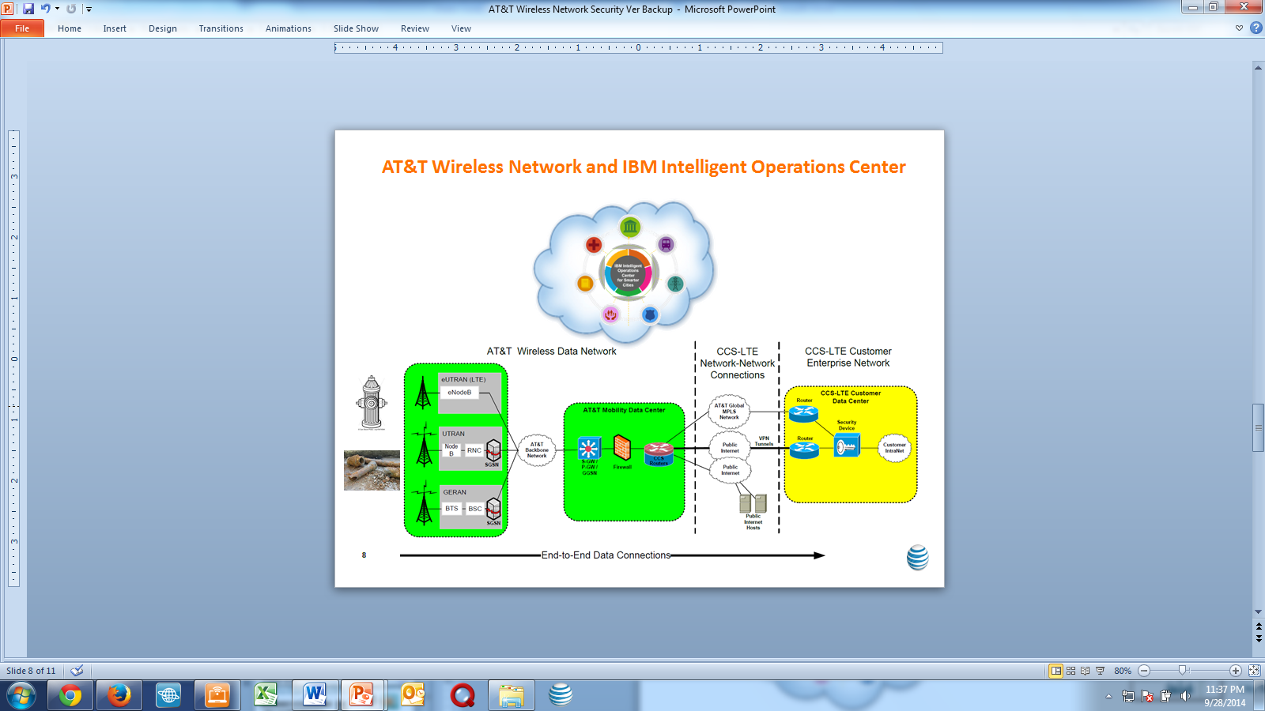
Demonstration
Use wireless network (LTE) and sensory inputs to a smart dashboard to address water sustainability and protect the potable water system from unauthorized use / threats a smart cities
Sensor would be placed in the water and lighting infrastructure
Water Infrastructure
AT&T
Network (LTE)
M2M device manager
Location Information
Video surveillance
Secure Network Connection
IBM analytics
IBM Intelligent Ops Center
Utility
IBM IOC
5
4
Utility
1
2
3

Slide 8
Domains / Sectors
Potable Water
Lighting
Parking
Wastewater
Electric
Call Out : Need more cities and technology participants

